Slide 1

Norm Group Characteristics
Oli Clark

Slide 2
This Video
Sampling Distributions
Sample characteristics
Standard scores
Deviations

Slide 3
Describing Groups
Latent Variable Modelling
Classical Test Theory
Sum Score
Mean Score
Strongly Disagree | Slightly Disagree | Neither Agree nor Disagree | Slightly Agree | Strongly Agree
Notes:
We now have a set of items that represent a construct that we are interested in. We have a couple of ways to deal with these items. We can use the latent variable theory approach and look at probabilities that likert point will be selected – or we can take a classical test theory approach which is what we will be doing in this module. When we decide to summarise the set of items into a single number as per CTT we can either take the sum of all of the items, or we can take the mean average score of the items. If we are measuring ability, so if there are correct or incorrect items, the sum scores are more informative – for example – you got 30 out of 35 correct. This is not the case with personality attributes – when participants answer these questionnaires, it’s usually on a likert scale that ranges, for example, from strongly disagree to strongly agree. A score of 20/50 on an extraversion scale is not as easy to interpret. If we take the mean of the 10 items then we end up with 3/7 which can be matched to a point on a likert scale – this can be reported back to the user such that ‘A score of 2 on the means that you slightly disagree with items related to extraversion’.

Slide 4
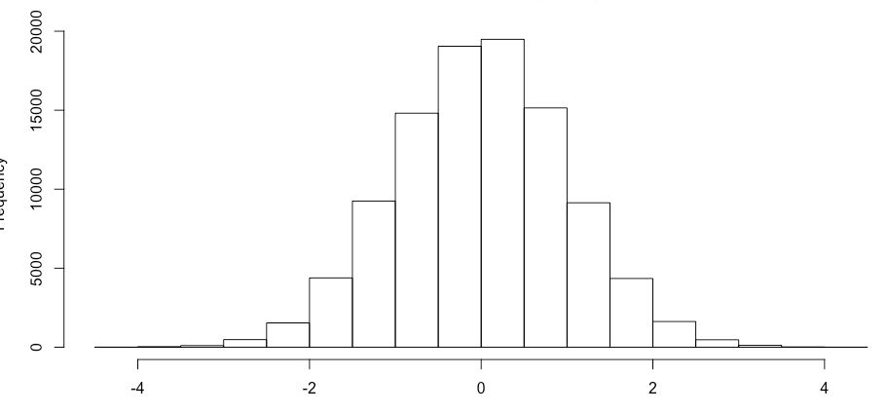
Sampling Distributions
Notes:
Once we have a single sum or a mean score for a person, by extension we assume that if everybody in the whole world took the measure, then we would know what a typical score is, and how much variation in these scores we would expect to see. Unfortunately this would be virtually impossible to do, so we have to take smaller, representative, samples and make inferences about the population from this.
If we were to do this, [click] we would expect that the vast majority of scores would fall around the mean average, and as scores get more extreme they become much rarer – this creates what is known as a normal distribution which is shaped like a bell. In a non-skewed normal distribution, the mean, median, and mode are in the same position – right in the middle.
Because we assume this shape at a population level, we also need to make sure this pattern is represented in any samples that we take.

Slide 5
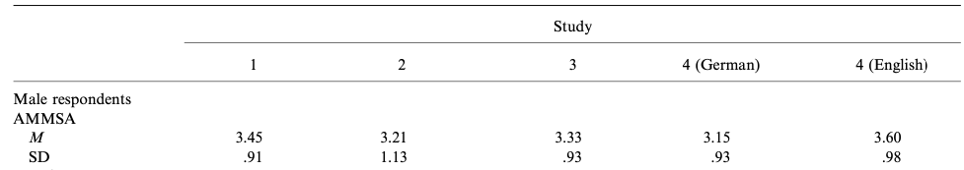
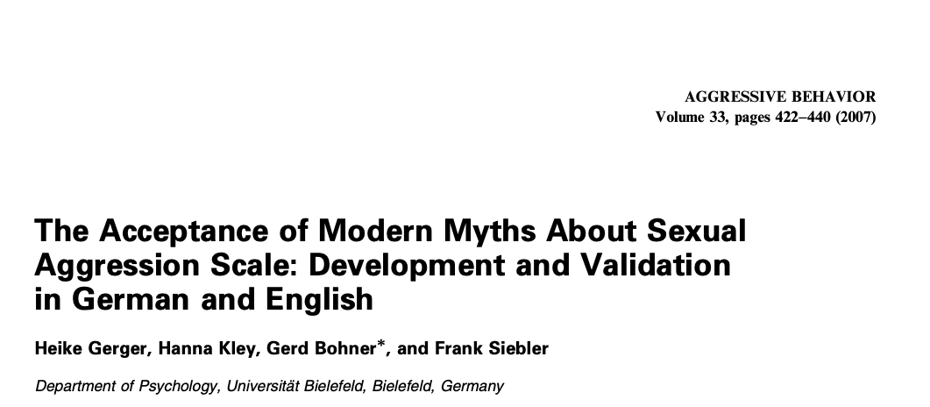
Sampling Distributions
Notes:
Let’s take an example – if everyone in the whole world completed the Acceptance of Modern Myths about Sexual Aggression scale [click[ – we would know what the global mean and standard deviation were. Gerger and others couldn’t do this in 2007, so they ran four studies with a total of 1279 participants and attempted to estimate the population mean – the values of which can be seen in their paper. Because these are not population means [click], there will be sampling error, and we can see that the mean dashes about between studies, and will continue to under replications. This is because of sampling error, and the degree to which the sample mean dashes about is quantified as the Standard Error of the Mean. A large standard error of the mean will mean that repeated samples will have wildly different means. A well constructed study with a representative sample will be ‘good enough’.

Slide 6
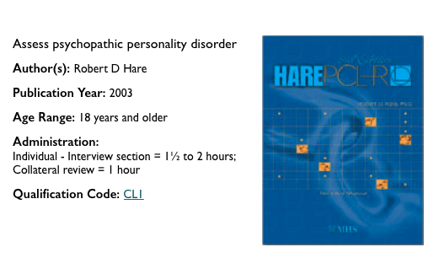
Norm Groups
Notes:
We will be comparing individuals to a norm group in this module. A norm group is a sample of people who have completed a measure in order to estimate the population mean and standard deviation. These need to be representative of the people who will eventually be measured. You will find norm group characteristics in any assessment manual, including the PCL-R, HCR-20, and other forensic measures. Inside these manuals you will find means and standard deviations for different ages and genders, reliability measures, etc. Moreover, you can get norm group information from validation papers such as that by Gerger et al. However, it is recommended that you create your own norm groups, which is what we have done for this module.

Slide 7
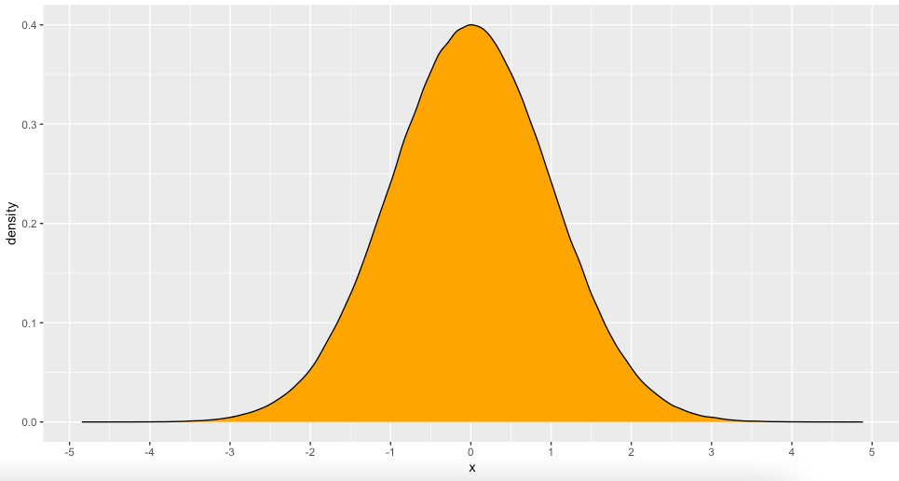
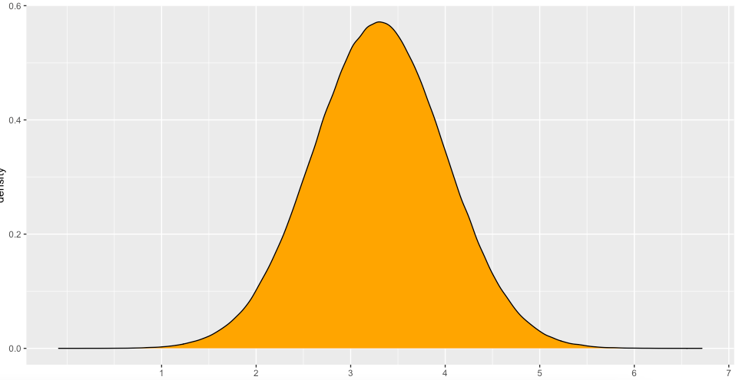
Norm Groups
Mean = 3.30, SD = 0.7
Notes:
Once we have a norm group, we can start interpreting the ranges of different scores. A useful feature of the normal distribution is that we know what percentages of observations would fall between different values. Take the following example – this is a normal distribution with a mean of zero and a standard deviation of one. This means that the x-axis is in standard deviation units – someone who gets a score of 1 is one standard deviation above the mean [click] - we can say the same thing about the AMMSA data – the mean was 3.30 and the SD was 0.7 – so someone with a score of 4 would be one standard deviation above the mean, and someone with a score of 2.6 would be one standard deviation below the mean.

Slide 8
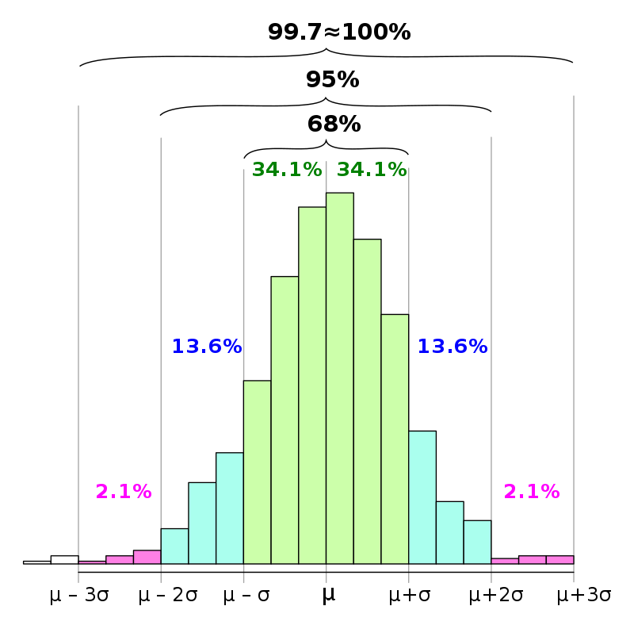
Norm Groups
Notes:
We call a normal distribution with a mean of 0 and a standard deviation of 1 a standard normal distribution, and we call standard deviation units z scores. So if a person has a z score of -1 they are 1 standard deviation below the mean. The normal distribution has known characteristics [click][click]. We know that if a sample is normally distributed, that 68% of scores will fall between ± 1 z score or standard deviation, denoted here as sigma; we know that between ±2 standard deviations, there are 95% of scores, and between ±3 standard deviations 99.7% of scores will fall – outside of these are extreme outliers. So on the AMMSA scale, 68% of people who take it should fall between 2.6 and 4.0.

Slide 9
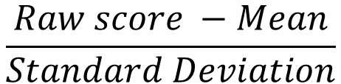
Norm Group: Standard Scores
S | Raw | Z score
1 | 1.36 | -1.52
2 | 2.27 | -0.86
3 | 3.77 | 0.23
4 | 4.97 | 1.10
5 | 4.15 | 0.50
6 | 2.51 | -0.68
7 | 6.12 | 1.93
8 | 2.89 | -0.41
9 | 3.39 | -0.04
10 | 3.10 | -0.26
$$\frac{Raw score −Mean}{Standard Deviation}$$
M = 3.45
SD = 1.38
Notes:
We can use norm group information to create standard scores that are expressed in z scores – to do this we take the mean from each score and then divide by the standard deviation. A set of data that you apply this transformation to will then have a mean of 0 and a standard deviation of 1. We call these standard scores Z scores.

Slide 10
Norm Group: Standard Scores
S | Raw | Z score
1 | 1.36 | -1.52
2 | 2.27 | -0.86
3 | 3.77 | 0.23
4 | 4.97 | 1.10
5 | 4.15 | 0.50
6 | 2.51 | -0.68
7 | 6.12 | 1.93
8 | 2.89 | -0.41
9 | 3.39 | -0.04
10 | 3.10 | -0.26
Notes:
We can use norm group information to create standard scores that are expressed in z scores – to do this we take the mean from each score and then divide by the standard deviation. A set of data that you apply this transformation to will then have a mean of 0 and a standard deviation of 1. We call these standard scores Z scores.

Slide 11
Norm Groups
Grand Mean = sum of means/number of means
(3.45 + 3.45 + 3.21 + 3.33 + 3.6) / 5 = (16.74)/5 = 3.348 ~ 3.35
Variance= sum of deviations / (number of deviations -1)
Notes:
Earlier I mentioned the standard error of the mean in relation to the AMMSA. The standard error of the mean is the standard deviation of differences in sample means. We can take a rough estimate from the gerger papers

Slide 12
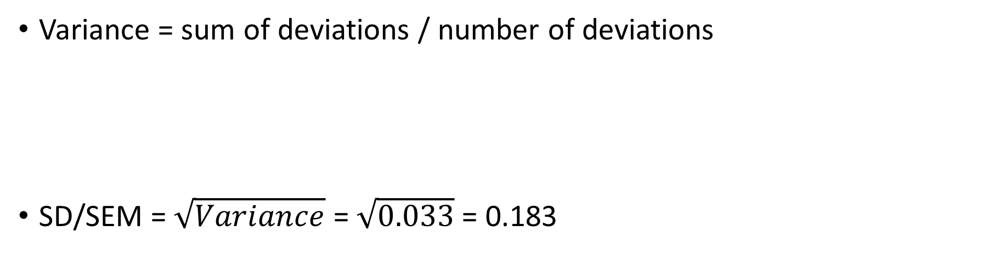
Norm Groups
Variance = sum of deviations / number of deviations
SD/SEM = $\sqrt{Variance}$ = $\sqrt{0.033}$ = 0.183
$$\frac{\text{ (3.35 – 3.45)}\text{2}\text{ + (3.35 – 3.21)}\text{ 2}\text{ + (3.35+3.33)}\text{ 2}\text{ + (3.35−3.15)}\text{ 2}\text{ + (3.35 −3.6)}\text{ 2} }{5−1}$$
Notes:
Earlier I mentioned the standard error of the mean in relation to the AMMSA. The standard error of the mean is the standard deviation of differences in sample means. We can take a rough estimate from the gerger papers

Slide 13
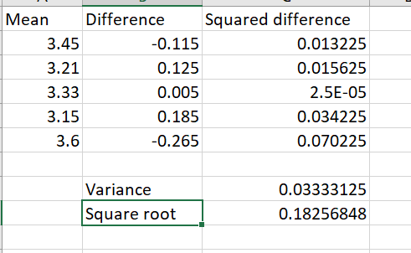
Norm Groups
Notes:
Earlier I mentioned the standard error of the mean in relation to the AMMSA. The standard error of the mean is the standard deviation of differences in sample means. We can take a rough estimate from the gerger papers

Slide 14
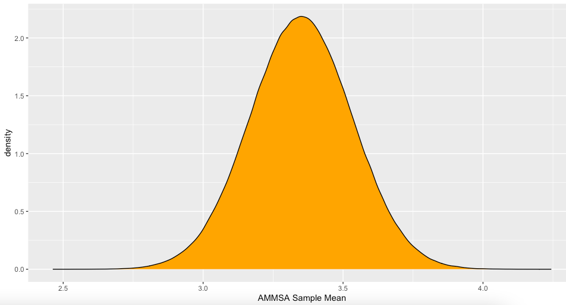
Norm Groups
Notes:
Once we have an estimate of sampling error, we can think about the long-run range of means that we would expect to observe under repeated samples. So based on the Gerger paper, if we assume incorrectly that this grand mean of means of 3.35 is a perfect representation of the population mean, and we have a standard error of 0.183 we can plot this as a normal distribution. Now we can say that we would expect 68% of means to fall between plus or minus one standard error of the mean. So in other words, if 10 of my dissertation students each took an independent sample of 200 participants, the 7 of their means would cluster around the population mean. Unfortunately we don’t know what the population mean is, so we can’t find out the exact standard error, but we can approximate it from the sample standard deviation and the sample size

Slide 15
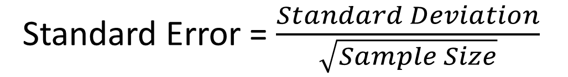
Norm Groups
Standard Error = $\frac{Standard Deviation}{\sqrt{Sample Size}}$
Notes:
Using this equation to estimate the standard error of the mean allows us to estimate the accuracy of our mean estimate

Slide 16
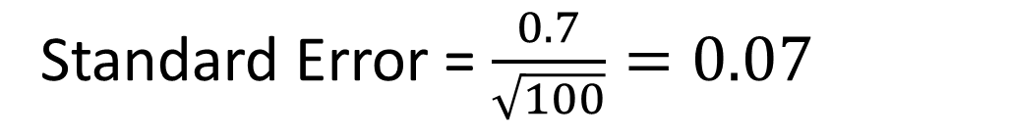
Norm Groups
We get an AMMSA sample mean of 3.12
We get an AMMA standard deviation of 0.7
We have a sample of 100
Mean estimate = 3.12, Confidence Interval [3.05, 3.19]
Standard Error = $\frac{0.7}{\sqrt{100}}=0.07$
Notes:
If we were to repeat this study 100 times, 68% of our means would be within plus or minus one standard error, and 95% of our means would be within 2 standard errors.
If we have captured the population mean, then 68% of scores will fall between these two values – but we don’t know if we’ve captured the population mean!

Slide 17
Summary
We need norm groups to interpret individual scores
Norm groups are generally only based on one sample – although they may be large enough and representative enough to be useful
We can use norm group to estimate how far away from the mean a person’s score is – these are called standard scores

